Slide 1

Operating System Concurrency
Understanding the foundations of concurrent computing

Slide 2



Why Concurrency Matters in Operating Systems
Concurrency is a fundamental OS concept that enables efficient resource utilization and responsive computing. Modern systems must handle multiple tasks simultaneously—from running background processes to managing user interactions.
Better Performance
Responsiveness
Multi-User Support
Maximize CPU utilization by overlapping computation with I/O operations
Keep applications interactive while performing background work
Enable multiple users and programs to share system resources fairly
Without concurrency, computers would be limited to executing one task at a time, drastically reducing efficiency and user experience.

Slide 3

Key Terminology: Breaking Down the Concepts
Concurrency
1
The illusion of simultaneous execution. Multiple tasks make progress by rapidly switching between them on a single processor.
Parallelism
2
True simultaneous execution. Multiple tasks run at exactly the same time on multiple processors or cores.
Process
3
An independent program with its own memory space, resources, and execution context. Processes are isolated from each other.
Thread
4
A lightweight unit of execution within a process. Threads share the same memory space but execute independently.

Slide 4
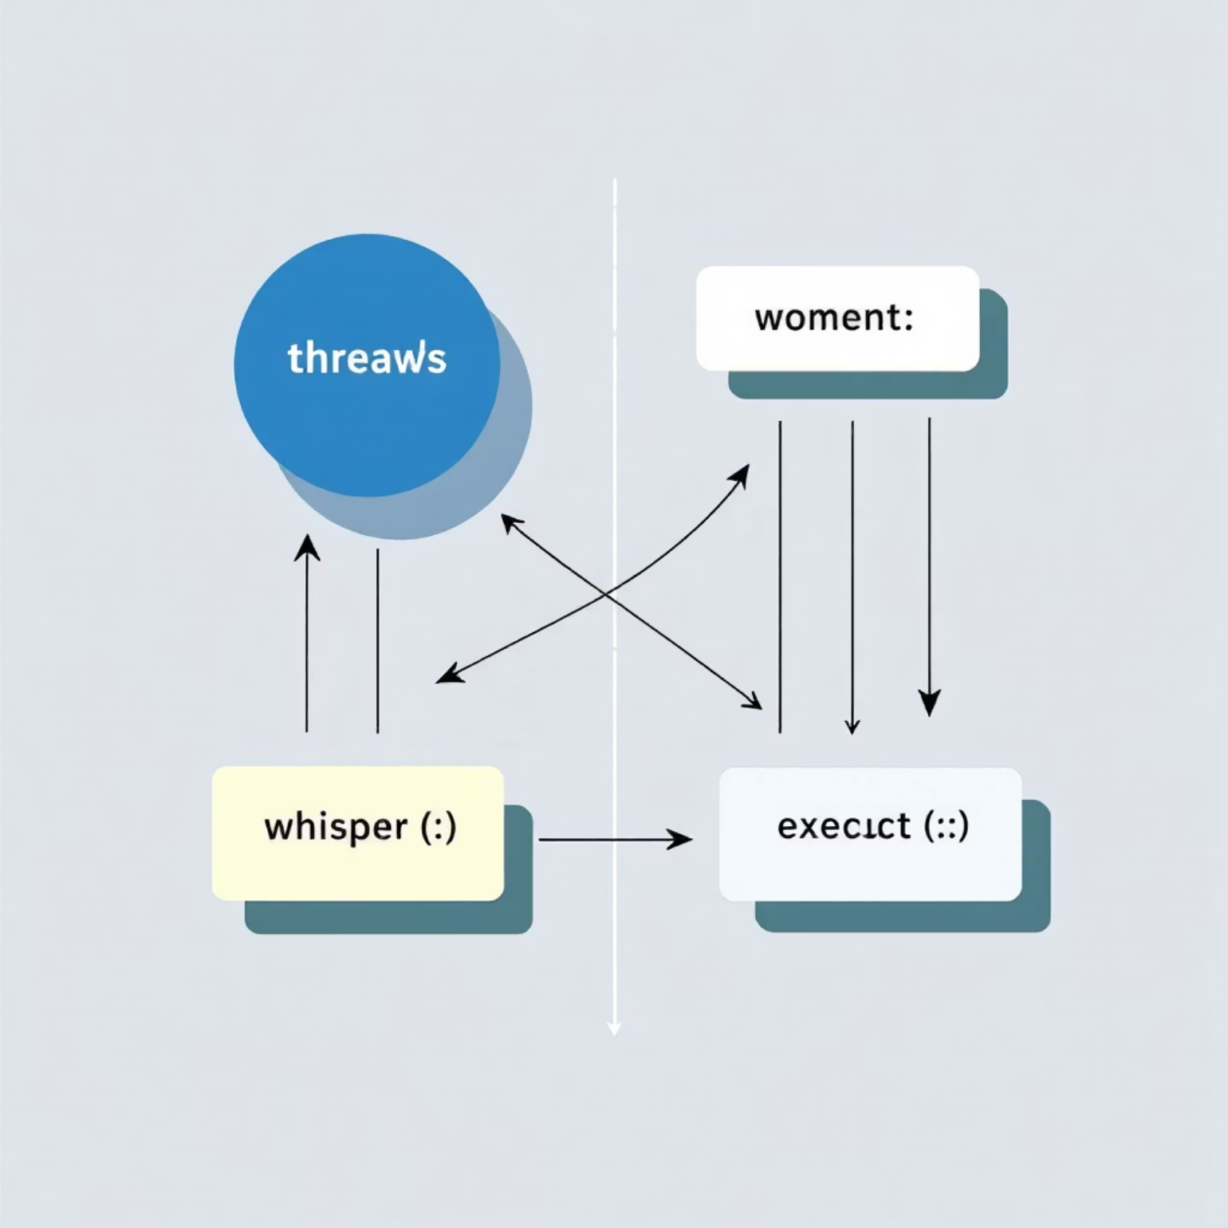

Race Conditions: When Concurrency Goes Wrong
A race condition occurs when the program's behavior depends on the unpredictable timing or ordering of concurrent operations. The outcome "races" based on which thread executes first.
Classic Example: Bank Account
balance = 100Thread A: balance = balance + 50Thread B: balance = balance + 30
Expected result: 180Possible result: 130 or 150!
Both threads read the same initial value before either writes back, causing one update to be lost.
Why They Occur: Shared memory access combined with non-atomic operations and unpredictable thread scheduling creates the perfect storm for race conditions.

Slide 5



Three Pillars of Correct Concurrent Execution
To write correct concurrent programs, we must ensure three critical properties are maintained:
Visibility
Ordering
Changes made by one thread must be visible to other threads at the right time. Memory caches and compiler optimizations can hide updates without proper synchronization.
Atomicity
Operations must execute in a predictable sequence when dependencies exist. The program must control when certain operations happen relative to others.
Operations must execute as indivisible units—either completely or not at all. No thread should observe partial results of another thread's work.
Violating any of these properties can lead to subtle, difficult-to-debug errors in concurrent programs.

Slide 6
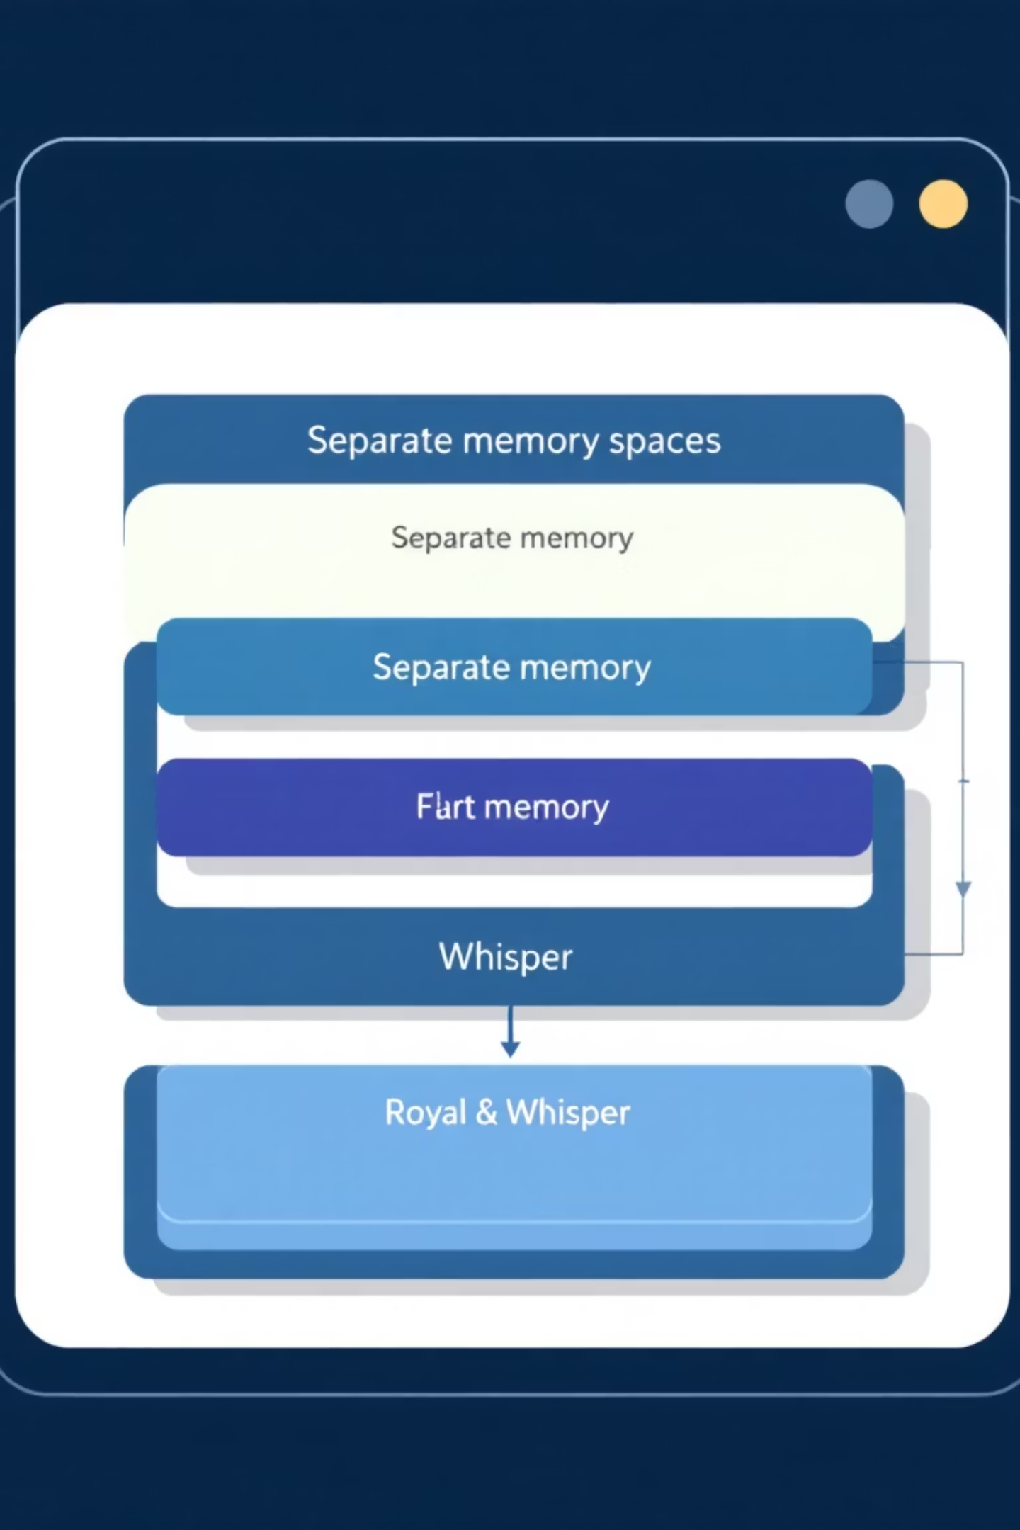
The Process Model and Its Limitations
How Processes Work
Key Limitations
Each process has its own isolated address space, file descriptors, and system resources. The OS switches between processes to create concurrency.
Heavyweight: Creating processes is slow and memory-intensive
Expensive switching: Context switches involve significant overhead
Strong isolation and security
Complex communication: Sharing data requires pipes, sockets, or shared memory
Process switching saves/restores full context
Communication requires IPC mechanisms
Resource duplication: Each process duplicates resources unnecessarily

Slide 7
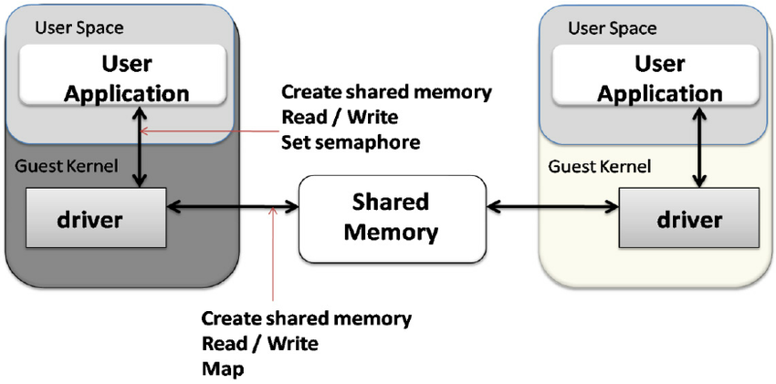

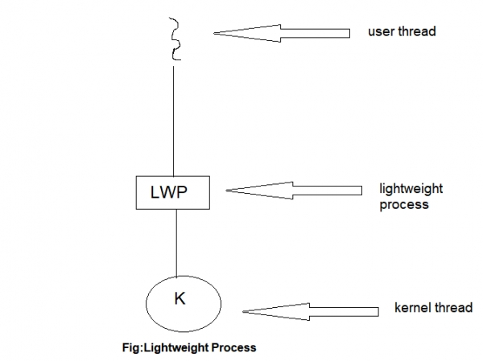
The Thread Model: Lightweight Concurrency
Threads solve the process model's limitations by providing lightweight, efficient concurrency within a single process.
Shared Memory
Fast Switching
Lightweight Creation
All threads in a process share the same address space, making communication fast and simple—just read/write shared variables.
Thread context switches are much faster because they don't require switching memory spaces or many system resources.
Creating threads is significantly faster and uses less memory than creating new processes—perfect for scalable applications.
Threads enable responsive user interfaces, efficient server architectures, and better utilization of multi-core processors.

Slide 8
User-Level vs. Kernel-Level Threads
User-Level Threads
Managed entirely by user-space libraries without kernel involvement. The kernel sees only a single process.
Advantages: Fast creation, switching, and scheduling with no system calls
Disadvantages: Blocking calls stall the entire process; no true parallelism on multi-core systems
Kernel-Level Threads
Managed directly by the OS kernel. The kernel schedules each thread independently.
Advantages: True parallelism on multi-core CPUs; blocking calls don't affect other threads
Disadvantages: Higher overhead for creation and switching due to system calls
Modern systems often use hybrid models that map multiple user threads onto kernel threads for the best of both approaches.

Slide 9
Thread Lifecycle: States and Transitions
Threads transition through several states during their lifetime, managed by the OS scheduler:
New
1
Thread created but not yet started
2
Ready
Waiting for CPU time from the scheduler
Running
3
Currently executing on a CPU
4
Blocked
Waiting for I/O or synchronization
Terminated
5
Finished execution
Understanding these states is crucial for debugging concurrency issues and optimizing thread performance. Threads move between ready, running, and blocked states many times during execution.

Slide 10
Key Takeaways: Mastering OS Concurrency
Concurrency is Essential
Modern operating systems rely on concurrency for performance, responsiveness, and resource sharing across multiple users and applications.
Threads vs. Processes
Threads provide lightweight concurrency with shared memory, while processes offer isolation. Choose based on your needs.
Correctness Requires Discipline
Ensure atomicity, ordering, and visibility to avoid race conditions. Concurrent programming demands careful synchronization.
Implementation Matters
Understanding user-level vs. kernel-level threads and thread lifecycles helps you write efficient, correct concurrent programs.

